Slide 1
Can we predict your education?
Attempting to determine education level using data from OkCupid

Slide 2
Introduction
We were given a dataset from OkCupid, an online dating website
There were over 50000 users’ data in the dataset
The information in the dataset included:
age, body type, diet, drinks, drugs, education, ethnicity, height, income, job, last time online, location, offspring, orientation, pets, religion, sex, sign, smokes, speaks, status and the responses to several essay questions.
We explored the data for a while and questions arose naturally…

Slide 3
Question 1
Can we use people’s habits with various substances (cigarettes, alcohol and drugs) to predict their education level?

Slide 4
Method
Smoking: Users could choose from 5 attitudes. We ranked them from “least” to “most” and repeated that idea with subsequent rankings.
No, when drinking, trying to quit, sometimes, yes
Drinking: Users could choose from 6 attitudes.
Not at all, rarely, socially, desperately, often, very often
Drugs: Users could choose from 3 attitudes.
Never, sometimes, often
Education: Users could choose from 32 statuses! We split these into four loose categories, but for visualization purposes we graphed all 32 statuses on upcoming slides.
high school, some college, college, more than college

Slide 5
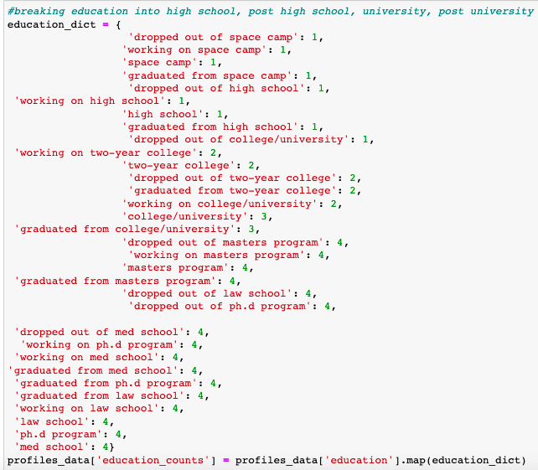
New columns
After organizing rankings we mapped those numbers into new columns called “_____ counts” with the blank space being the name of the feature.
I didn’t want to change the original columns in my data frame because I wasn’t sure if I would have different questions as time went on.
An example is on the right.
After we had the new columns we could visualize the data.

Slide 6
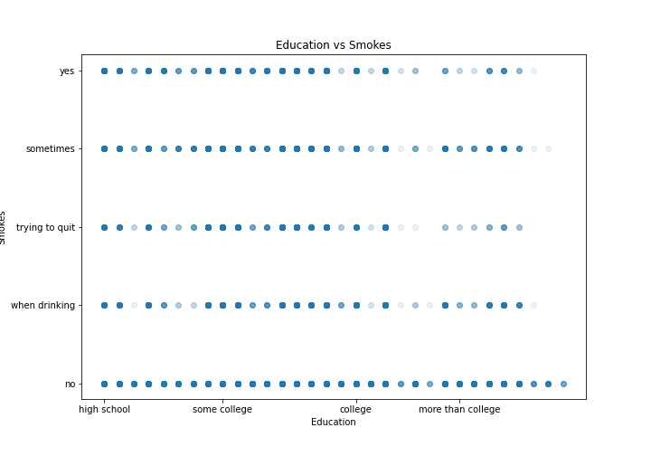
Education vs smoking

Slide 7
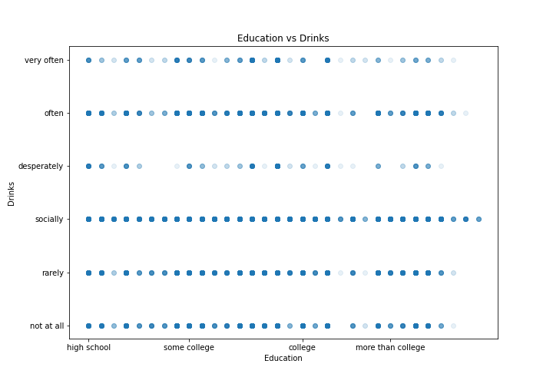
Education vs drinking

Slide 8
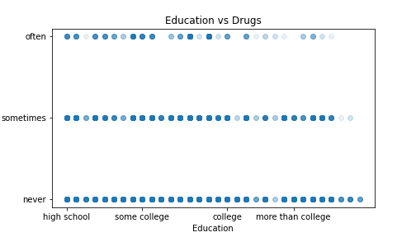
Education vs drugs

Slide 9
Predicting education with machine learning
The graphs of substances vs education showed faint patterns. The data seemed to be less clustered as education levels increased, giving us hope that we would be able to use machine learning to group people together.
We first attempted the K Means algorithm which we were hoping would show meaningful clusters that could lead to predictions.

Slide 10
K means
The K Means algorithm split the data into clusters based off of education, smoking, drinking and drugs. We ran the algorithm more than once. In general two clusters with strong patterns would emerge but the data wasn’t telling. One of the times we ran it produced the following two (out of four) clusters of note.
Cluster 0:
-100% have some kind of post 4-year university experience -92% don't do drugs -80% drink socially -96% don't smoke
Cluster 1:
-68% 4-year university experience -86% don’t do drugs -78% drink socially -94% don’t smoke

Slide 11
K means
After seeing the similarity in numbers regardless of education level, I checked the data and realized that the most popular responses to smoking, drinking and drugs were “no”, “socially” and “never”, respectively. That seemed to be the main factor in limiting the effectiveness of K Means grouping.
From there I decided to use the education level as the labels for the data and see if I could predict education levels with K Neighbors algorithm. At this point I was starting to doubt that substances could predict education levels. I wanted the K Neighbors algorithm to confirm that suspicion.
I also felt it would be easier to test other features in the K Neighbors algorithm. The fact that an accuracy score is built in makes it easier to evaluate the model.

Slide 12
Question 2
Will a K Neighbors algorithm be more effective in predicting education levels?

Slide 13
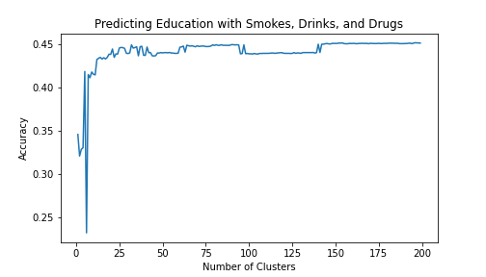
Using substances to predict education
Adding more clusters didn’t improve the accuracy of our model which topped out at 45%
We isolated variables but never got the accuracy above 50%
A human would, presumably, have a 25% chance of guessing one of four education levels so our model is more accurate than an uneducated guess.

Slide 14
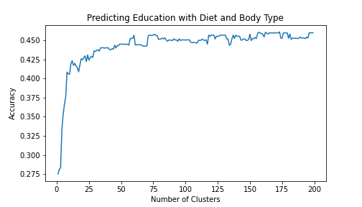
Using Diet and Body Type to predict education
Diet and Body Type proved to be about as effective as substances when predicting education level.
Body Type was ranked from ”smaller” to “bigger”
Diet was ranked from “strict” to ”less strict”

Slide 15
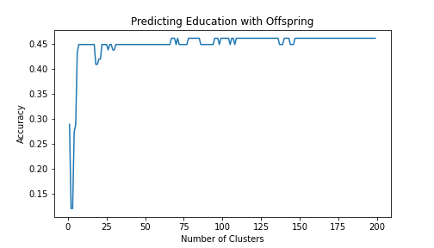
Using Offspring to predict education
Again the model tops out at around 45%
Offspring was organized with 3 levels: 0 kids, 1 kid, more than 1 kid.

Slide 16
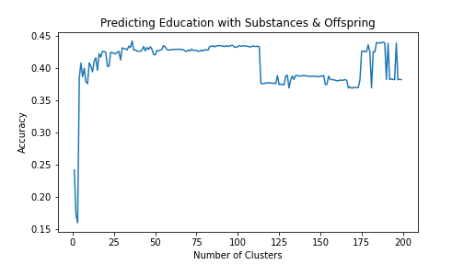
Using Offspring and Substances to predict education
Again the model tops out at around 45%

Slide 17
Switching it up
At this point I felt like the models were not strong for a number of reasons that I’ll recount at the end. I wondered if I could do better using language to predict education levels.

Slide 18
Question 3
Can we use word usage to predict education levels?

Slide 19
OkCupid essay Questions
"My Self Summary"
"What I'm doing with my life”
"I'm really good at"
"The first thing people notice about me"
"Favorite books, movies, shows, music, and food"
"The six things I could never do without"
"I spend a lot of time thinking about"
"On a typical Friday night I am"
"The most private thing I’m willing to admit"
"You should message me if”

Slide 20
Naïve bayes classifier
I dropped all of the users from the dataset who didn’t answer all 10 essay questions. I felt this would give us all of the people who felt “seriously” about answering questions.
I turned the essays into a list and added education levels as labels.
I tried all 10 questions at first but then I eliminated questions 5 and 6 because the answers tend to be more like “listicles”; maybe we could improve the model with questions that helped users display their literary talents.
Using all 10 questions
46.32% accuracy score
Using 8 questions
46.17% accuracy score

Slide 21
Can the model guess my education level?
"My Self Summary” – I’ve lived in China for the last decade. I like books, basketball, math and rap music.
"What I'm doing with my life” - I’m currently using Code Academy to learn data science. Also sweating profusely at the gym each summer morning.
"I'm really good at” – Annoying people. It’s a very rare talent.
"The first thing people notice about me” – Probably that I’m tall but I’m not really tall as much as I’m just big in general.
"Favorite books, movies, shows, music, and food” - SKIP
"The six things I could never do without” - SKIP
"I spend a lot of time thinking about” - Why it is that we eat birds
"On a typical Friday night I am” – Almost always hanging out with my friends and having some drinks.
"The most private thing I’m willing to admit” - I’m more or less an open book. Should I tell you my blood type?
"You should message me if” – You shouldn’t. I’m happily married and also very, very annoying.

Slide 22
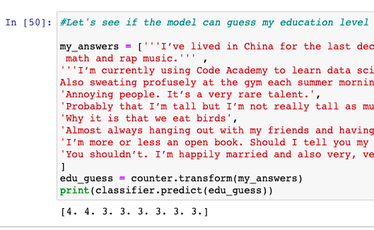
Results
The model guesses, based on my first two answers, that I have post-college educational experience. I don’t, unless you count Code Academy.
The model classifies me correctly on the other 6 questions.
Using the test data the model’s accuracy score was 42%.

Slide 23
Problem 1
Rankings

Slide 24
Rankings
The ranking system for several categories was flawed or unscientific, particularly with regards to body type and diet, not that those categories were seriously considered. I attempted to make the rankings as linear as possible but it’s not an easy task when there are choices like “anything” and “strictly anything” for diet; is there really a difference between those two choices? Or “space camp” for education; should I have simply dropped those rows as the answer could be considered “non-serious”?

Slide 25
Problem 2
Variance of Data

Slide 26
Variance of Data
Most of the people in the dataset answered questions about smoking, drinking and using drugs in similar ways. If we had data which included a larger variety of answers that might have helped us. On the other hand, more variety might not actually be an accurate representative sample of the population.

Slide 27
Conclusion 1
We can’t use THIS substance data to predict a person’s education level.

Slide 28
Conclusion 1
I wouldn’t be comfortable concluding anything else. Maybe education levels can be predicted using substance habit information with more/better data. Maybe there isn’t a correlation.
My suspicion is that more/better data might create a slightly more accurate model but that ultimately substance habits are not a great indicator of education level. The fact that diet, body type and offspring all managed to be nearly as accurate at predicting education levels suggests none of these are good indicators. More data, however, would need to be explored before reaching that conclusion definitively.

Slide 29
Conclusion 2
We can’t use these essay answers to predict a person’s education level.

Slide 30
Conclusion 2
Essay questions are not great for predicting education levels for several reasons: education levels don’t imply reading/writing level and vice versa (i.e. standardized tests, such as the GRE, are split into parts and graded differently); essay questions, especially on a dating site are not being graded for intellectual depth; America (most of this datasets locations were in the USA) is hope to diverse dialects and languages; etc.
If the questions were different or if the questions weren’t on a dating site in which people are writing casually we might have more success. Microsoft Word has a built-in readability function that measures the grade level of the writing of word documents. It might be interesting to look at the accuracy of that function.
If I were to continue this study I would want to either a) get longer responses from OkCupid users; they have voluntary questions that might be more revealing b) analyze a different writing dataset with varied education levels.
My suspicion is that essay questions are good for predicting a person’s reading/writing level and not their education.

